Slide 1
Describing Contingency Tables (Ch.2)
Jaehyoung Hong

Slide 2
Section
Section 2.1 : Basic terminology and notation
Section 2.2 : Comparing groups
Section 2.3 : Association
Section 2.4 : Extension for nominal and ordinal multicategory variables

Slide 3
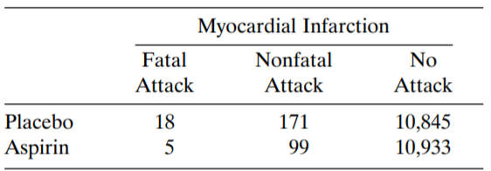
Contingency table describes frequency of X and Y
Y : Response variable
결과
X : Explanatory variable
Cell
실험 설정

Slide 4









Distribution of contingency table
$N$ : Total number
Joint distribution
$$π_{11}=18/N$$
$$π_{12}=171/N$$
$$……$$
$$π_{12}=10933/N$$
$$π_{i+}=\sum_{j}{π_{ij}}$$
$$π_{+j}=\sum_{i}{π_{ij}}$$
Marginal distribution
Conditional distribution
$$π_{1|1}=π_{11}/(π_{11}+π_{12}+π_{13})$$
Conditional distribution of Y at category $i$ of X

Slide 5
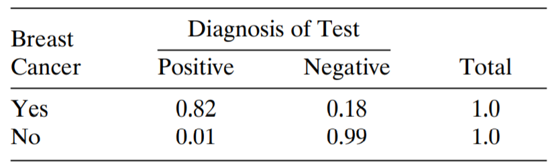


Sensitivity and Specificity
Sensitivity
$π_{11}=0.82$ : Has disease & Detect it
Correct Diagnosis
$π_{22}=0.99$ : No disease & Detect it
Specificity

Slide 6
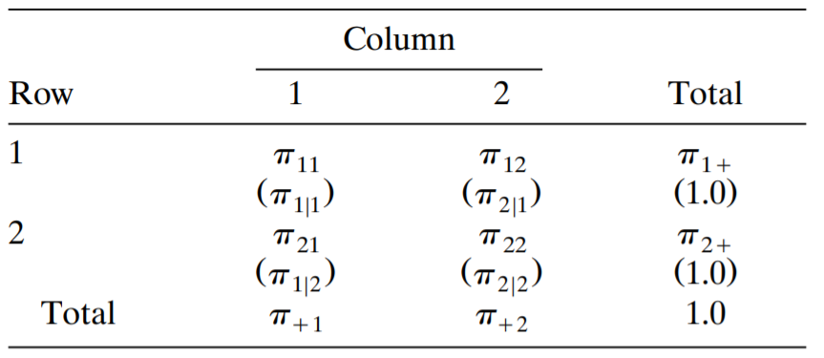
Notation

Slide 7
Independence
Independence
Property
$∴π_{j|1}=…=π_{j|I}$ for $j=1,…J$ if independent
Homogeneity

Slide 8
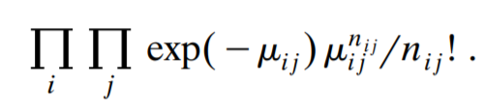
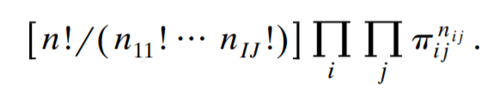
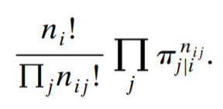
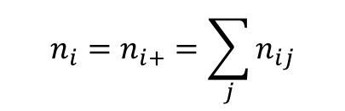

Poisson, Binomial, and Multinomial Sampling
Condition | Sampling | Probability
Nothing is fixed
$\left\{Y_{ij}\right\}$ as indep.Poisson with $\left\{μ_{ij}\right\}$
Total n is fixed
Multinomial sampling
Row totals fixed
(Y is indep when X is fixed)
Multinomial sampling for each row
$$n_{i}=n_{i+}=\sum_{j}{n_{ij}}$$

Slide 9
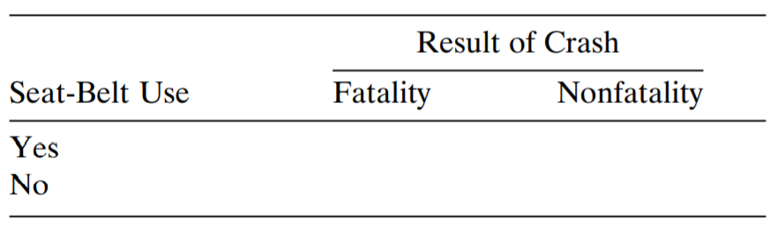

Example
Nothing is fixed
200 random sample
Multinomial variables with n=200 trials and unknown joint prob
Cross-sectional
100 random sample with fatality
Case-Control
(Retrospective)
Column sum is fixed : Binomial for each column
100 random sample with nonfatality
100 random sample with Seat-Belt
Cohort
(Perspective)
Row sum is fixed : Binomial for each row
100 random sample without Seat-Belt

Slide 10
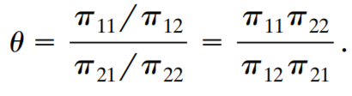
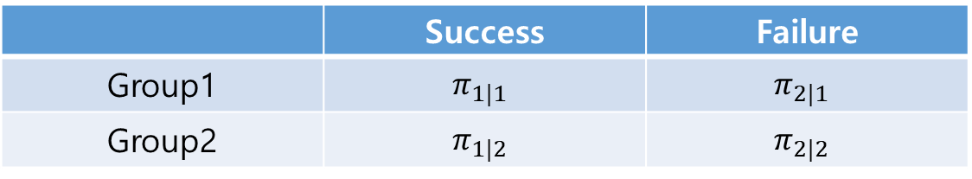
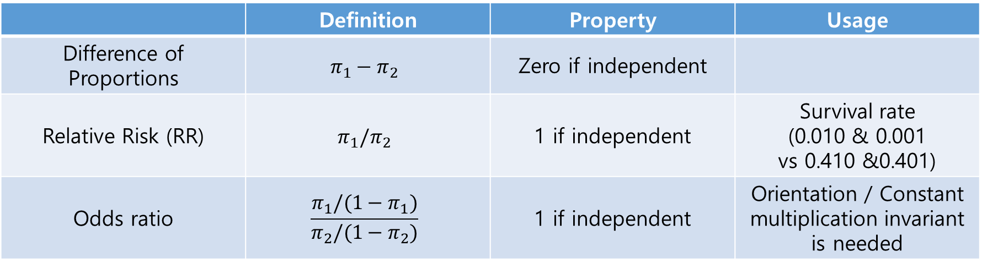
Comparing two groups : Difference, Relative risk, and Odd ratio
 | Success | Failure
Group1 | $$π_{1|1}$$ | $$π_{2|1}$$
Group2 | $$π_{1|2}$$ | $$π_{2|2}$$
 | Definition | Property | Usage
Difference of Proportions | $$π_{1}−π_{2}$$ | Zero if independent
Relative Risk (RR) | $$π_{1}/π_{2}$$ | 1 if independent | Survival rate (0.010 & 0.001 vs 0.410 &0.401)
Odds ratio | $$\frac{π_{1}/(1−π_{1})}{π_{2}/(1−π_{2})}$$ | 1 if independent | Orientation / Constant multiplication invariant is needed
Cross-product ratio

Slide 11
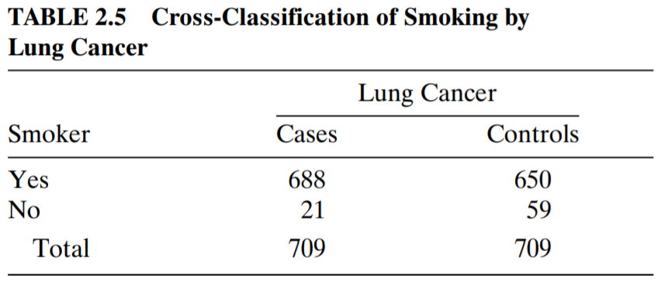
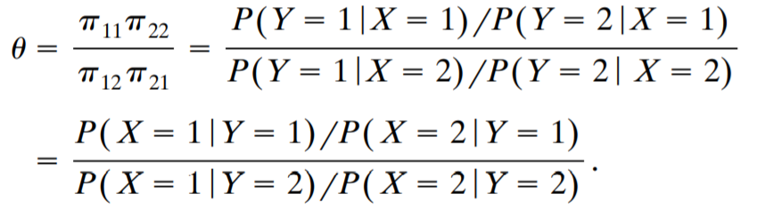
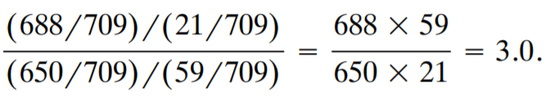

Odds ratio for case-control study
When smoking, Lung cancer increased?
Difference of proportion and RR has no-meaning (Since row-sum is not meaningful)
$$=$$
Odd is meaningful (Invariant under orientation)

Slide 12
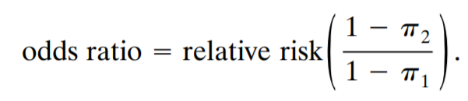
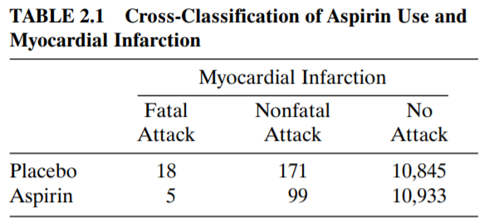
Relationship between Odds and RR
If $π_{1}$ and $π_{2}$ both small : Odd = RR
Odd can be interpreted as RR
RR = 1.82
Odd = 1.83
for having heart attack

Slide 13
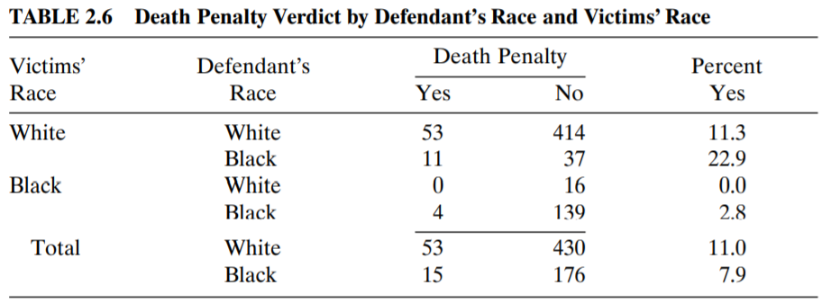
When ‘covariates’ matter : Partial table
Covariate : Factor that you must normalize
→ Victim (Z)
<Partial table>
<Marginal table>
Not normalizing, but ‘ignoring’

Slide 14

Partial table and marginal table can give different result
Partial table (W) : Black dependant have 22.9-11.3 = 11.6% more death penalty
Partial table (B) : Black dependant have 2.8-0.0 = 2.8% more death penalty
Marginal table : Black dependant have 11.0-7.9 = 2.1% less death penalty
Why? 1) Victim race ~ Defendant race : $odd=\frac{467×143}{48×16}=87$
2) Victim race ~ Death penalty

Slide 15
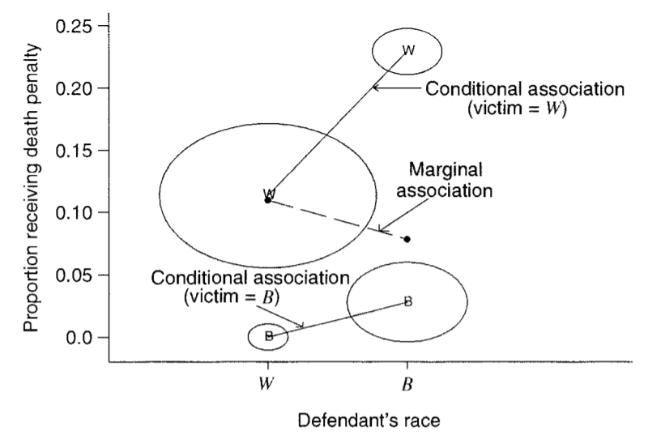
Partial table and marginal table can give different result
Simpson’s paradox
X축 : Explanatory
Y축 : Response
Center : Covariate
Circle size : number of pair between explanatory and covariate

Slide 16
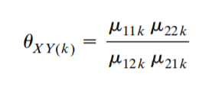
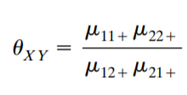




Conditional and marginal odds ratios
Odd for k-th partial table
(Conditional odds)
Odd for marginal table
$$=0$$
$${\hat{θ}}_{XY}=$$

Slide 17



Conditional and marginal independence
Conditionally independent at level k of Z
Conditionally independent given Z
Independent at every level of Z
Marginal independence, since

Slide 18
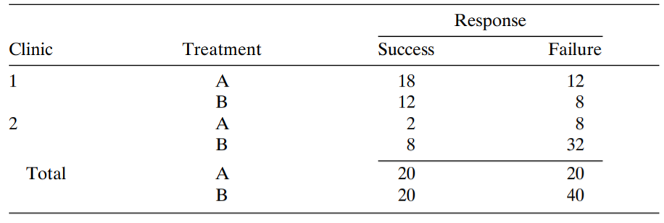



Conditional and marginal independence
Indep conditionally
Not Indep marginally
Why?
$$θ_{XZ}=$$
Clinic 1 tends to use Treat A

Slide 19
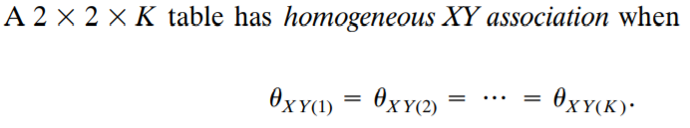
Homogenous association
XZ, YZ also homogeneous
Not homogeneous, but have trend among Z
$$θ_{XY(1)}>θ_{XY(2)}>θ_{XY(3)}$$
Z is called effect modifier

Slide 20
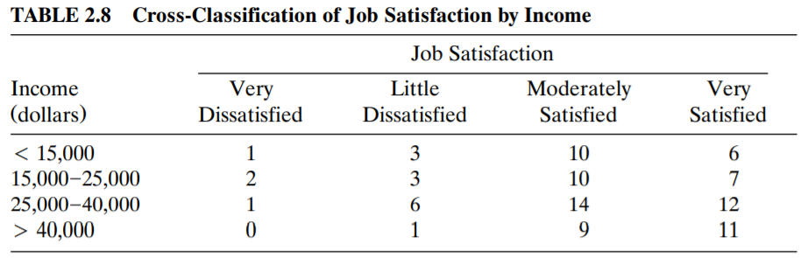
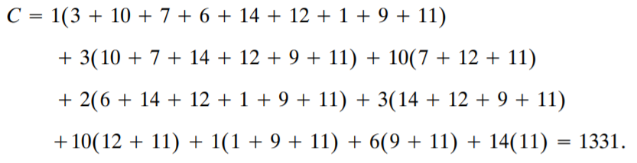

Ordinal trends : concordant and discordant pairs
Concordant pair
Tied pair
Discordant pair
$$>$$
Low income, low satisfaction

Slide 21
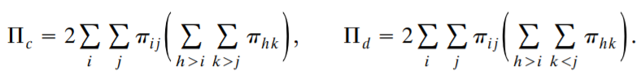
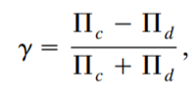

Ordinal trends : concordant and discordant pairs
Probability ver.
Property는 correlation과 동일

